Slide 1


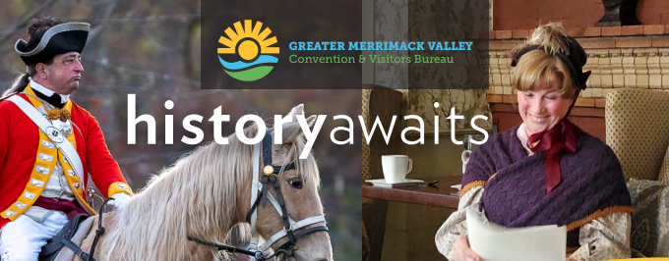
GREATER MERRIMACK VALLEY CONVENTION & VISITORS BUREAU
2023 OPEN HOUSE AGENDA
4:30pm Open House
5:15pm-5:30pm Welcome & Rev250 Celebration Discussion Points
6:30pm Open House Adjourn

Slide 2
Year 2025 marks the 250th anniversary of the historic Battles of Concord and Lexington on April 19, 1775 and the events leading to the signing of the Declaration of Independence on July 4, 1776.
These two communities, along with The State of MA commission on Rev250, have joined to commemorate these historic moments.
We invite you to learn more about how this series of 2025 events will impact tourism and business in the Greater Merrimack Valley and specifically how hotels leisure and group sales will be impacted during brief comments at each open house.

Slide 3
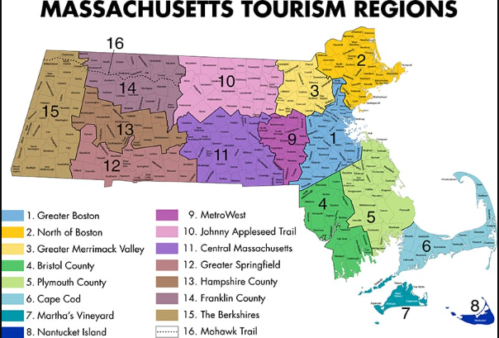
The Greater Merrimack Valley Convention & Visitors Bureau (GMVCVB) is the official destination marketing organization for the Greater Merrimack Valley.
We are designated by the Massachusetts Office of Travel & Tourism (MOTT) to market the region as a premier travel destination for domestic and international travelers; group tours and bus tours; meetings, conferences, and conventions; and sporting events.

Slide 4

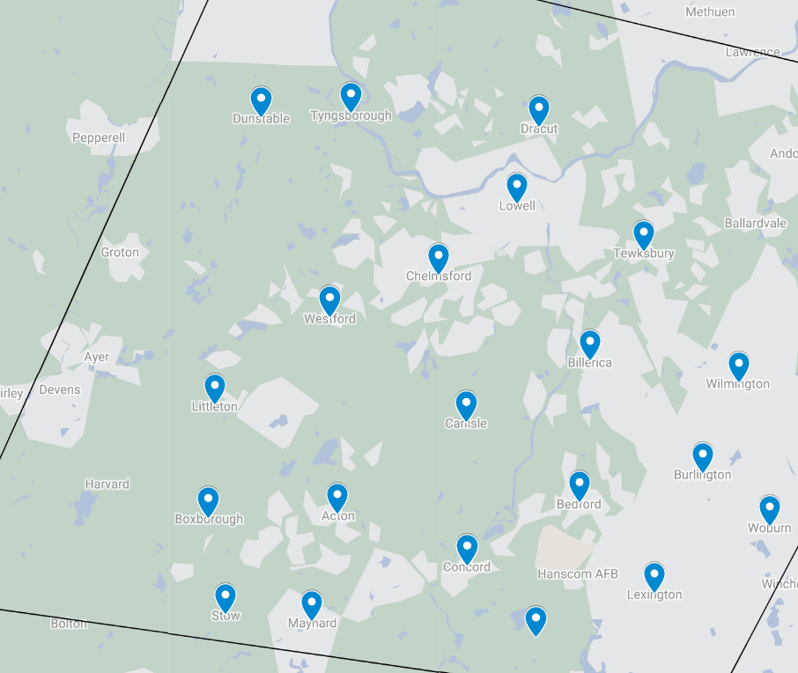
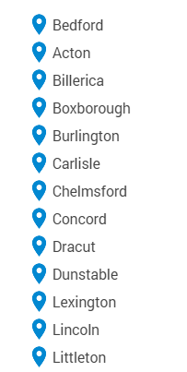
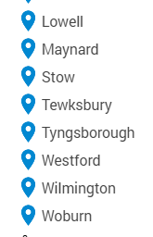

Slide 5
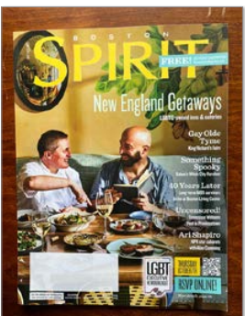
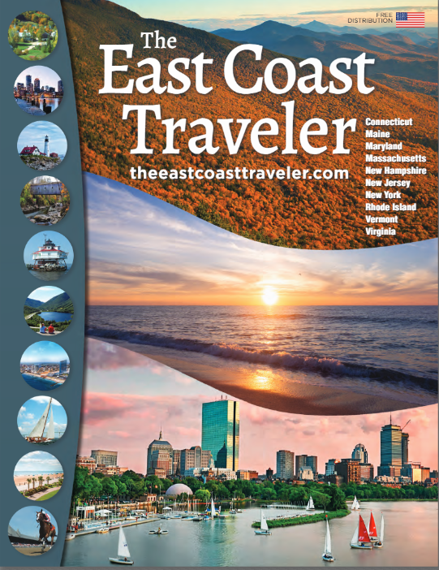

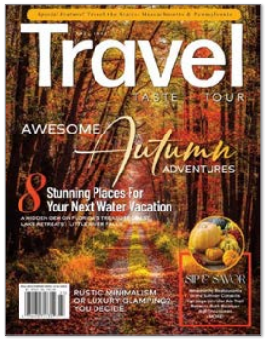
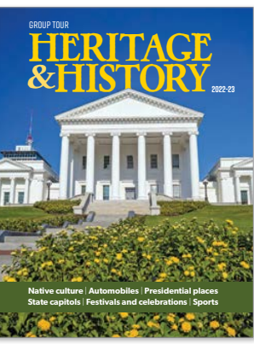
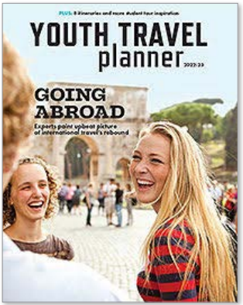
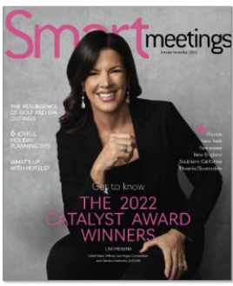
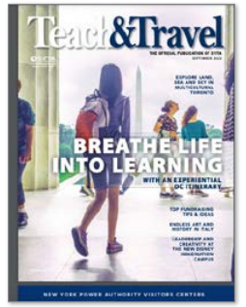

Collateral Campaign

Slide 6
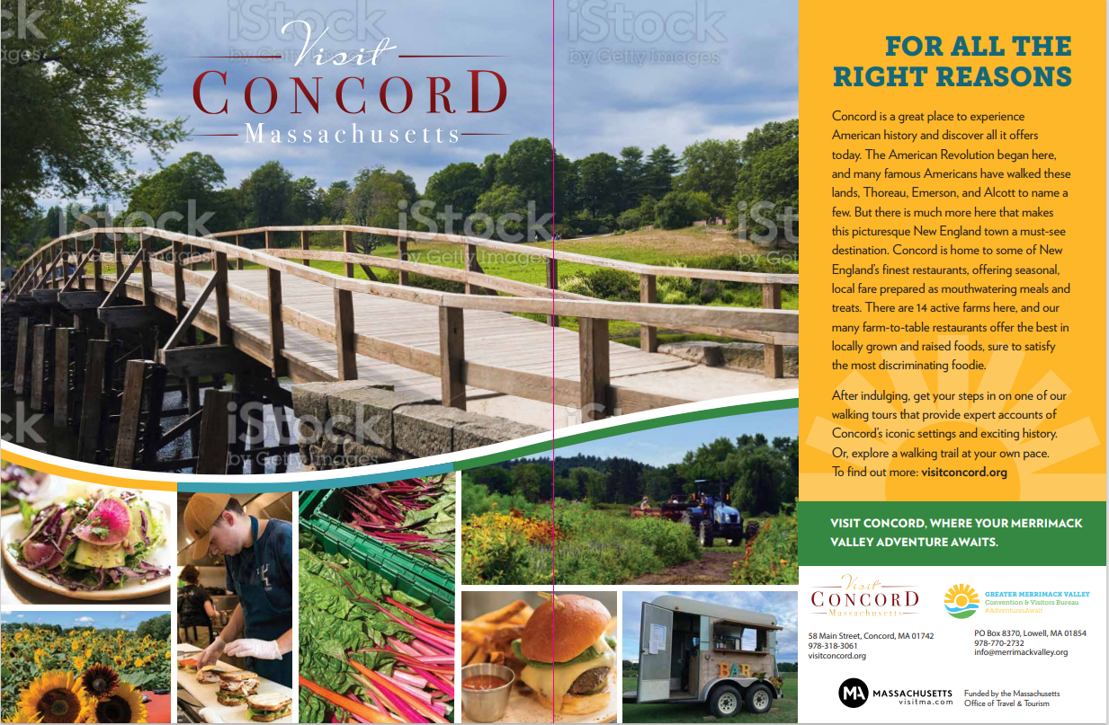


Slide 7
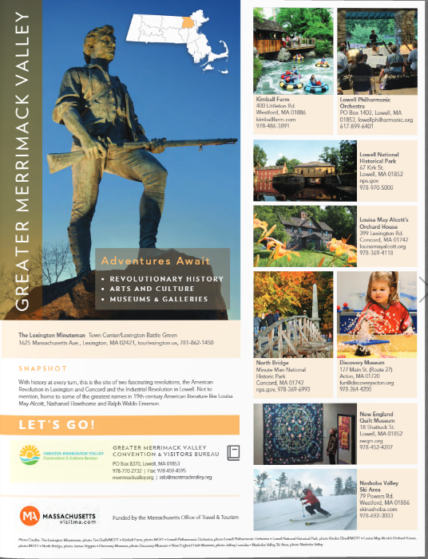
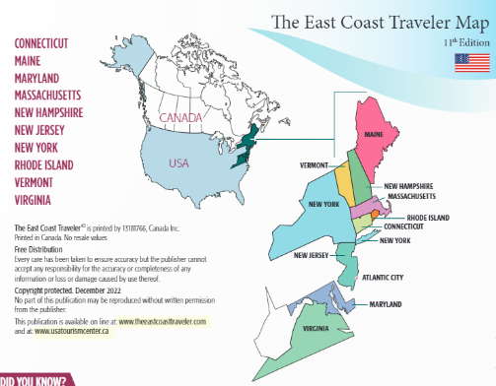

Slide 8
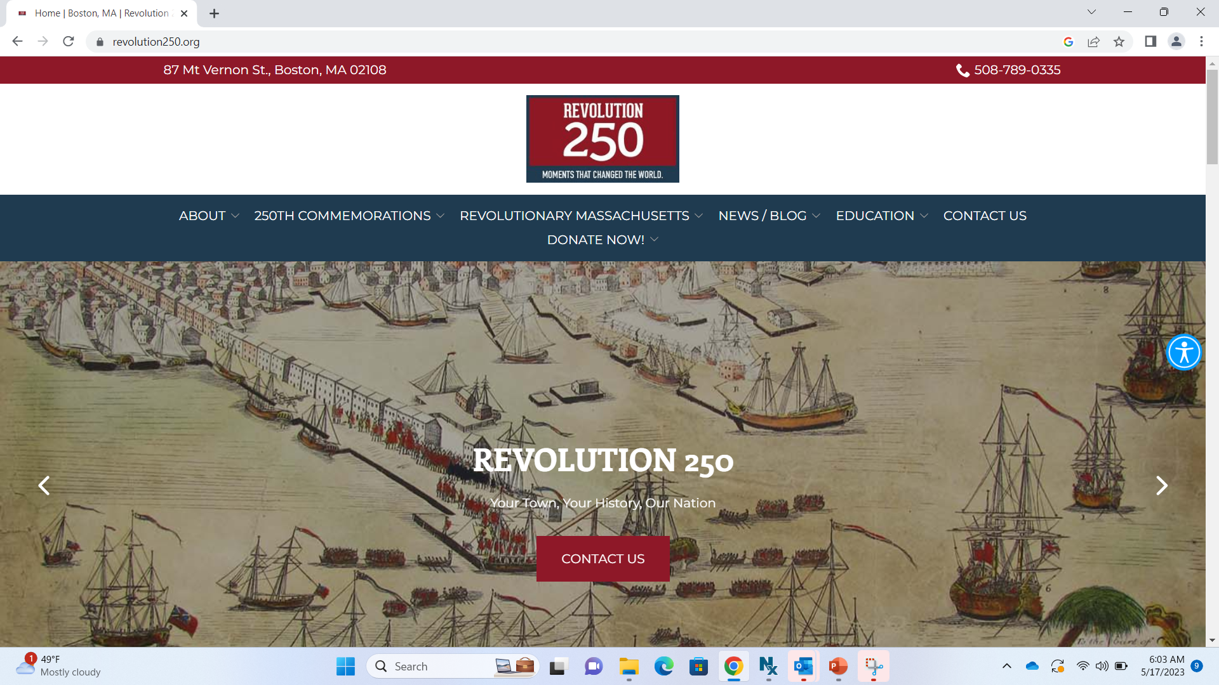

Slide 9


Slide 10

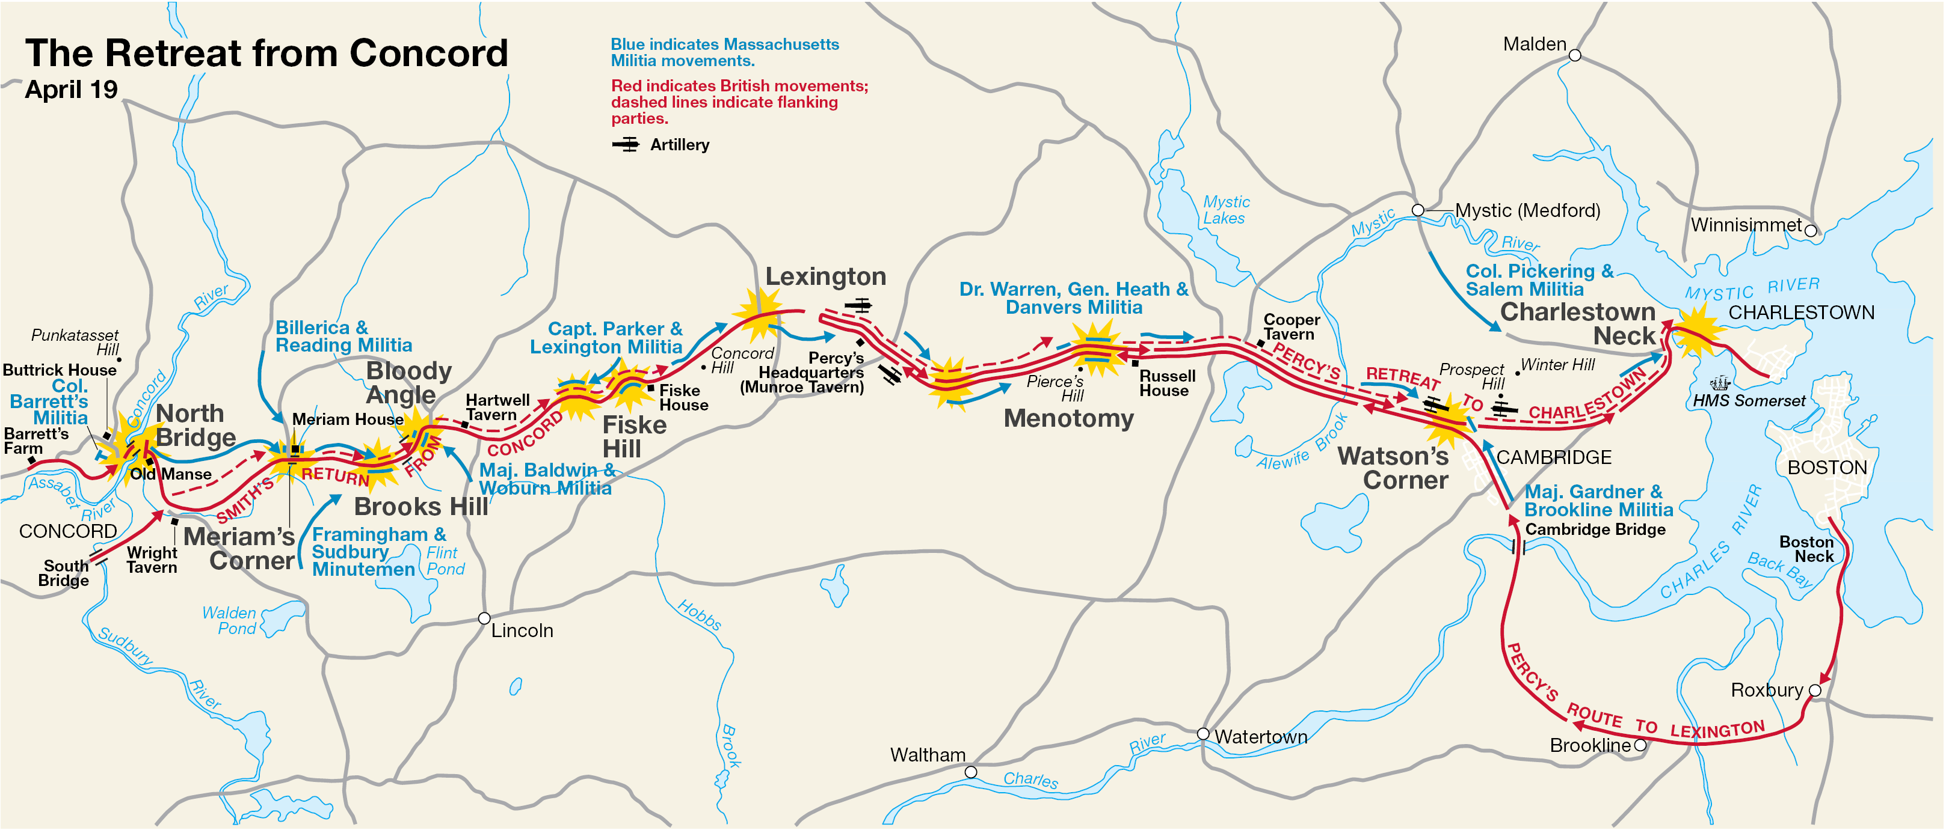
What Began on April 19, 1775…

Slide 11
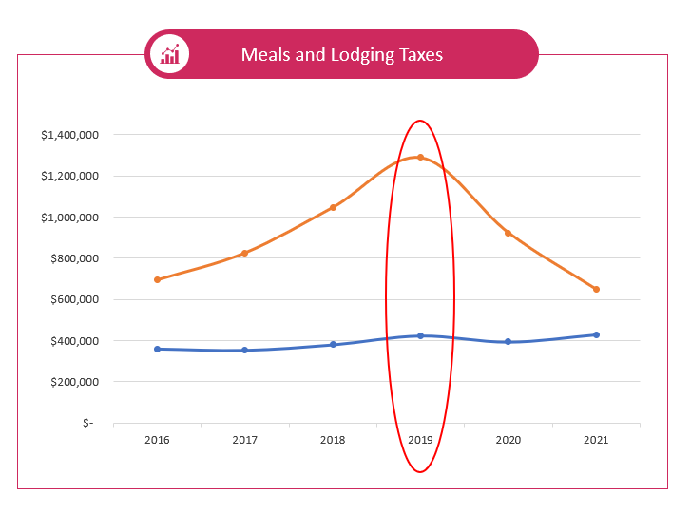
Hotel & Meal Taxes for the GMV

Slide 12
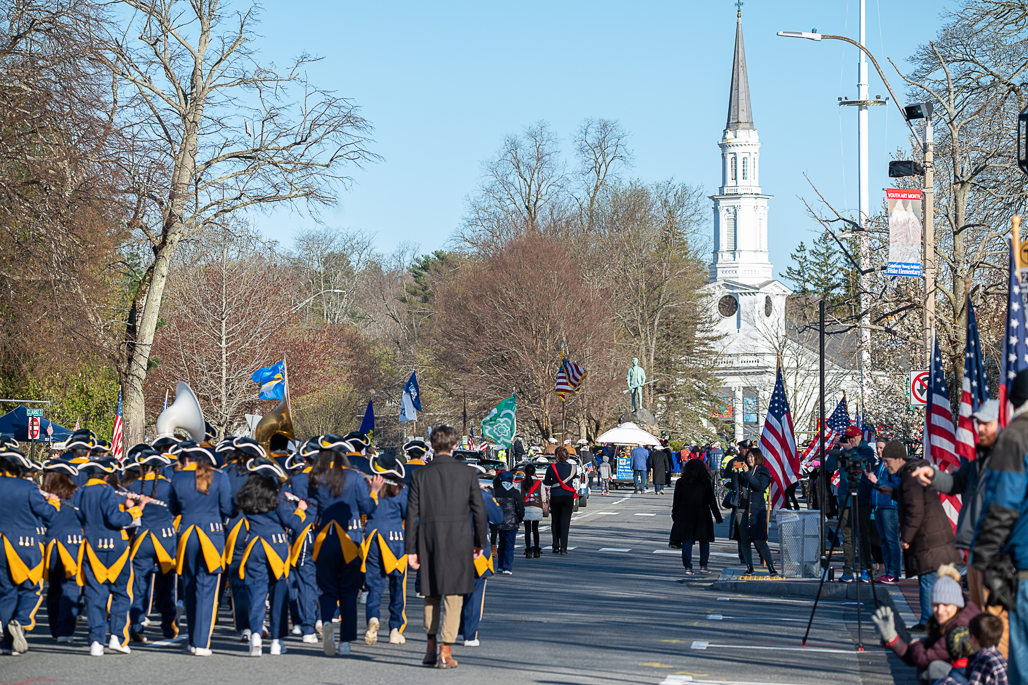
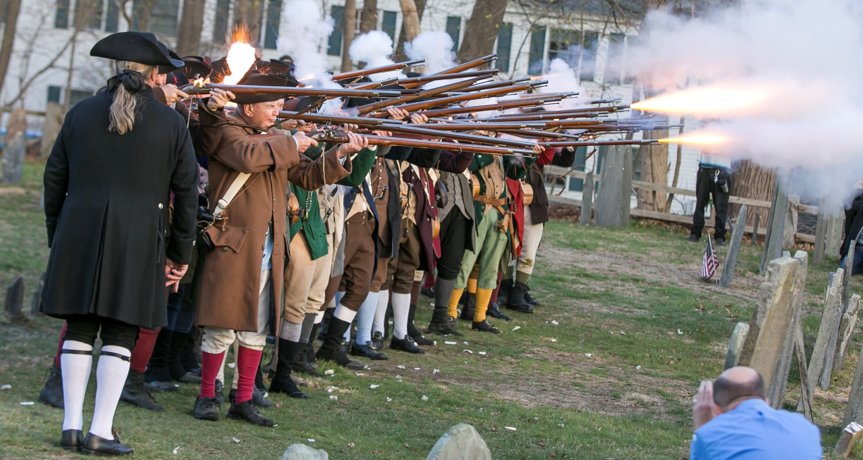
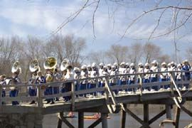
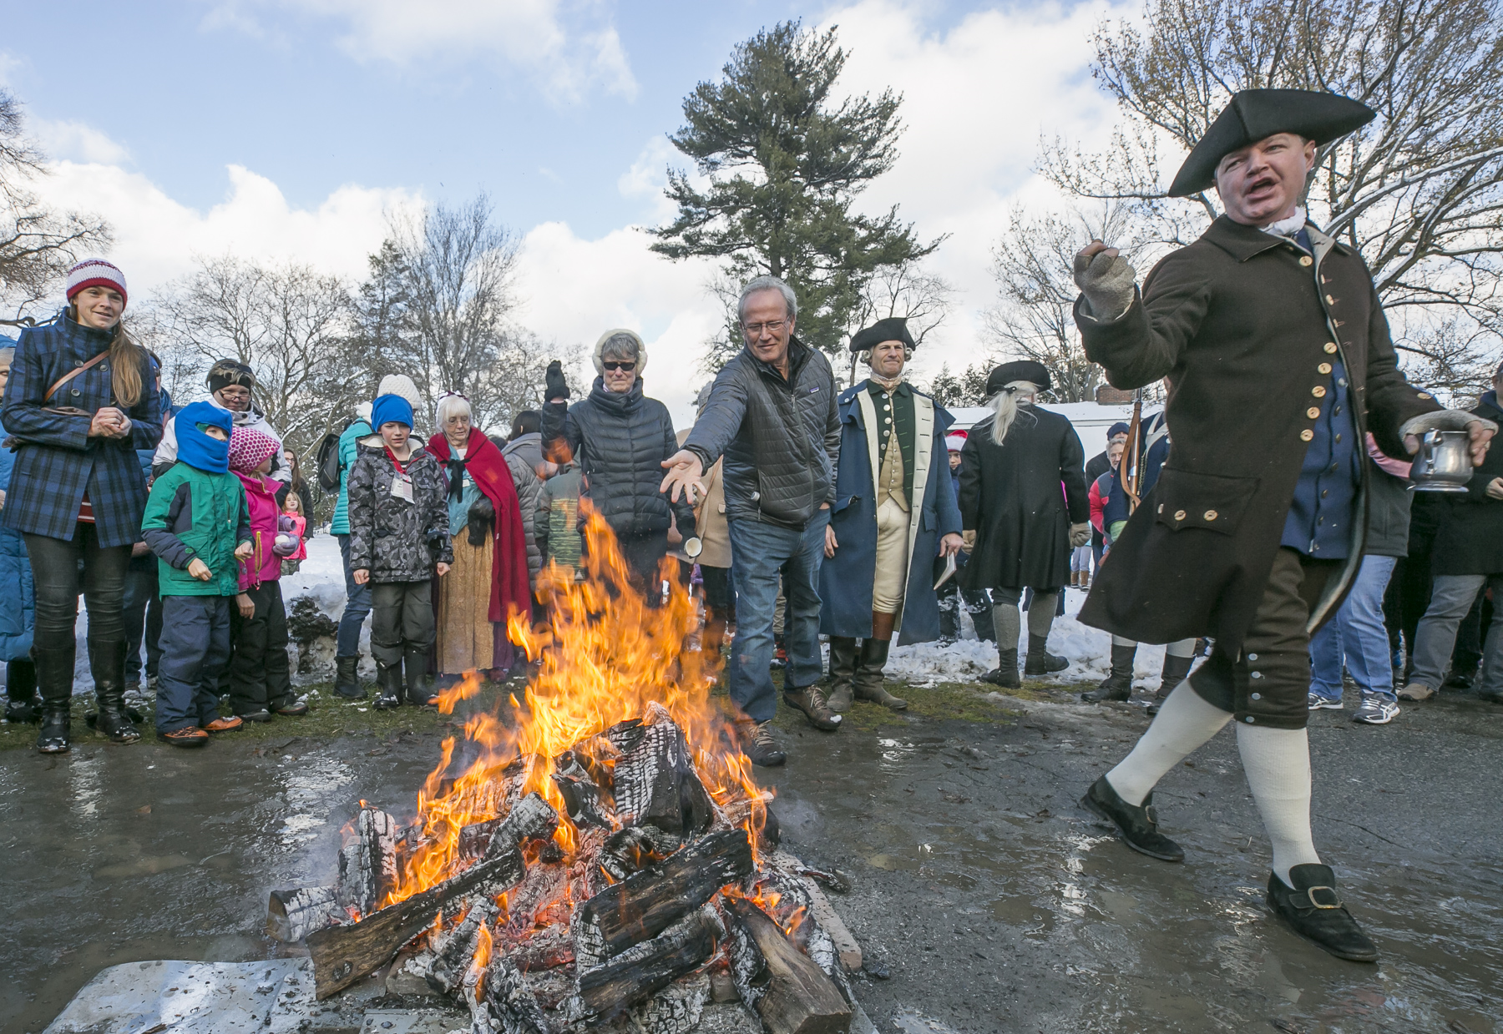
Regional Events

Slide 13
Q & A
Hotels
  Booking strategy
  Blackout dates
Types of event recommendation
Volume
What do they need from the communities?
Additional Points not covered in the conversation?
Quarterly Update?
Other Major events Happening in the region we should have on our radar?
Promotion?
Types of materials
Cross-promotion opportunities
Reach the current guests that are booking?

